Slide 1

AGILE DEVELOPMENT MODELS
CT&DT-SPSU-"ANONYMOUS"-MODULE 2- TASK#04

Slide 2
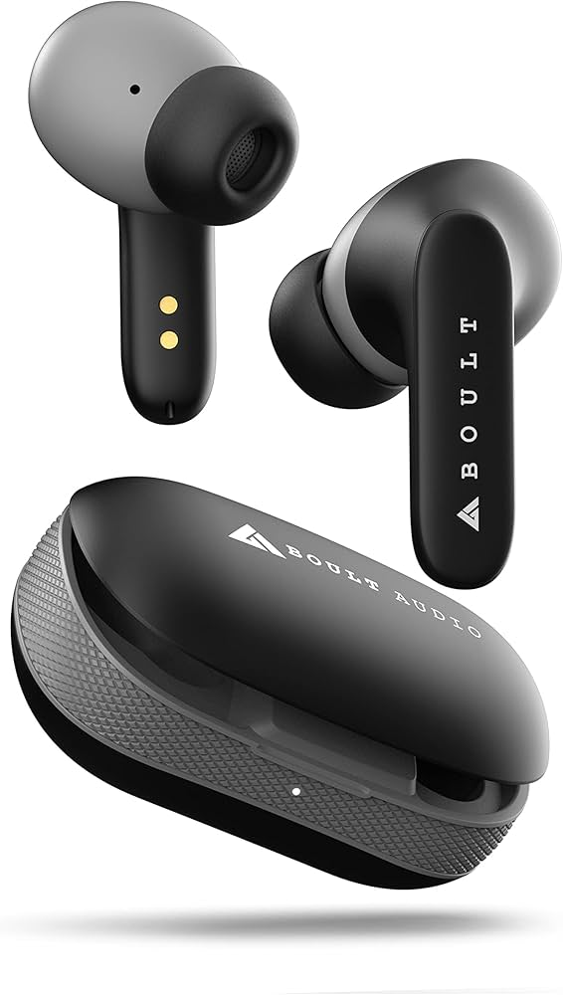
Development of Bluetooth Air Buds
The development of Bluetooth Air Buds involves an intricate blend of cutting-edge wireless technology, advanced acoustic and ergonomic design. The process is aimed at delivering high-quality sound while ensuring convenience and comfort for users.

Slide 3
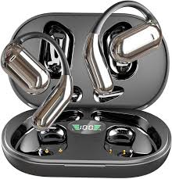
Design
1.Ergonomics:
Shape: Contoured to fit comfortably in the ear, reducing fatigue during long use.
Weight: Lightweight materials to enhance comfort and usability.
2.Materials:
Housing: Durable materials like polycarbonate or aluminum for robustness.
Ear Tips: Soft silicone or foam for a better seal and comfort.
3.Audio Quality:
Drivers: High-quality drivers for clear sound and good bass response.
Noise Cancellation: Active or passive noise isolation features.

Slide 4
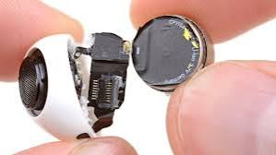
Design
4.Battery Life:
Capacity: Design for at least 5-8 hours of playback with a charging case for additional power.
Charging Options: USB-C or wireless charging capabilities.
5.Controls:
Touch or Button Controls: User-friendly interface for playback, volume and calls.
Voice Assistant Integration: Support for popular voice assistants.
6.Connectivity:
Bluetooth Version: Latest version(e.g., 5.0 or higher) for better range and stability.
Multi-Device Pairing: Ability to connect to multiple devices seamlessly.

Slide 5
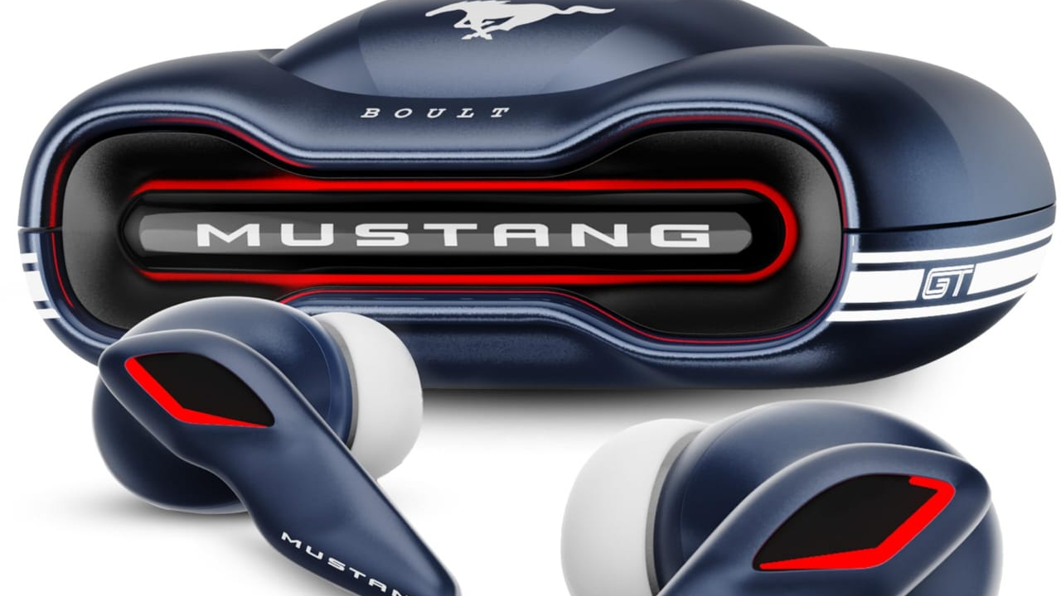
Design
7.Aesthetics:
Color Options: Variety of colors to appeal to different user preferences.
Design Language: Sleek, modern look that aligns with current tech trends.
8.Water Resistance:
Rating: IPX4 or higher for sweat and splash resistance.
9.Case Design:
Portability: Compact and lightweight charging case for easy transport.
Indicator Lights: Clear battery status indicators.

Slide 6
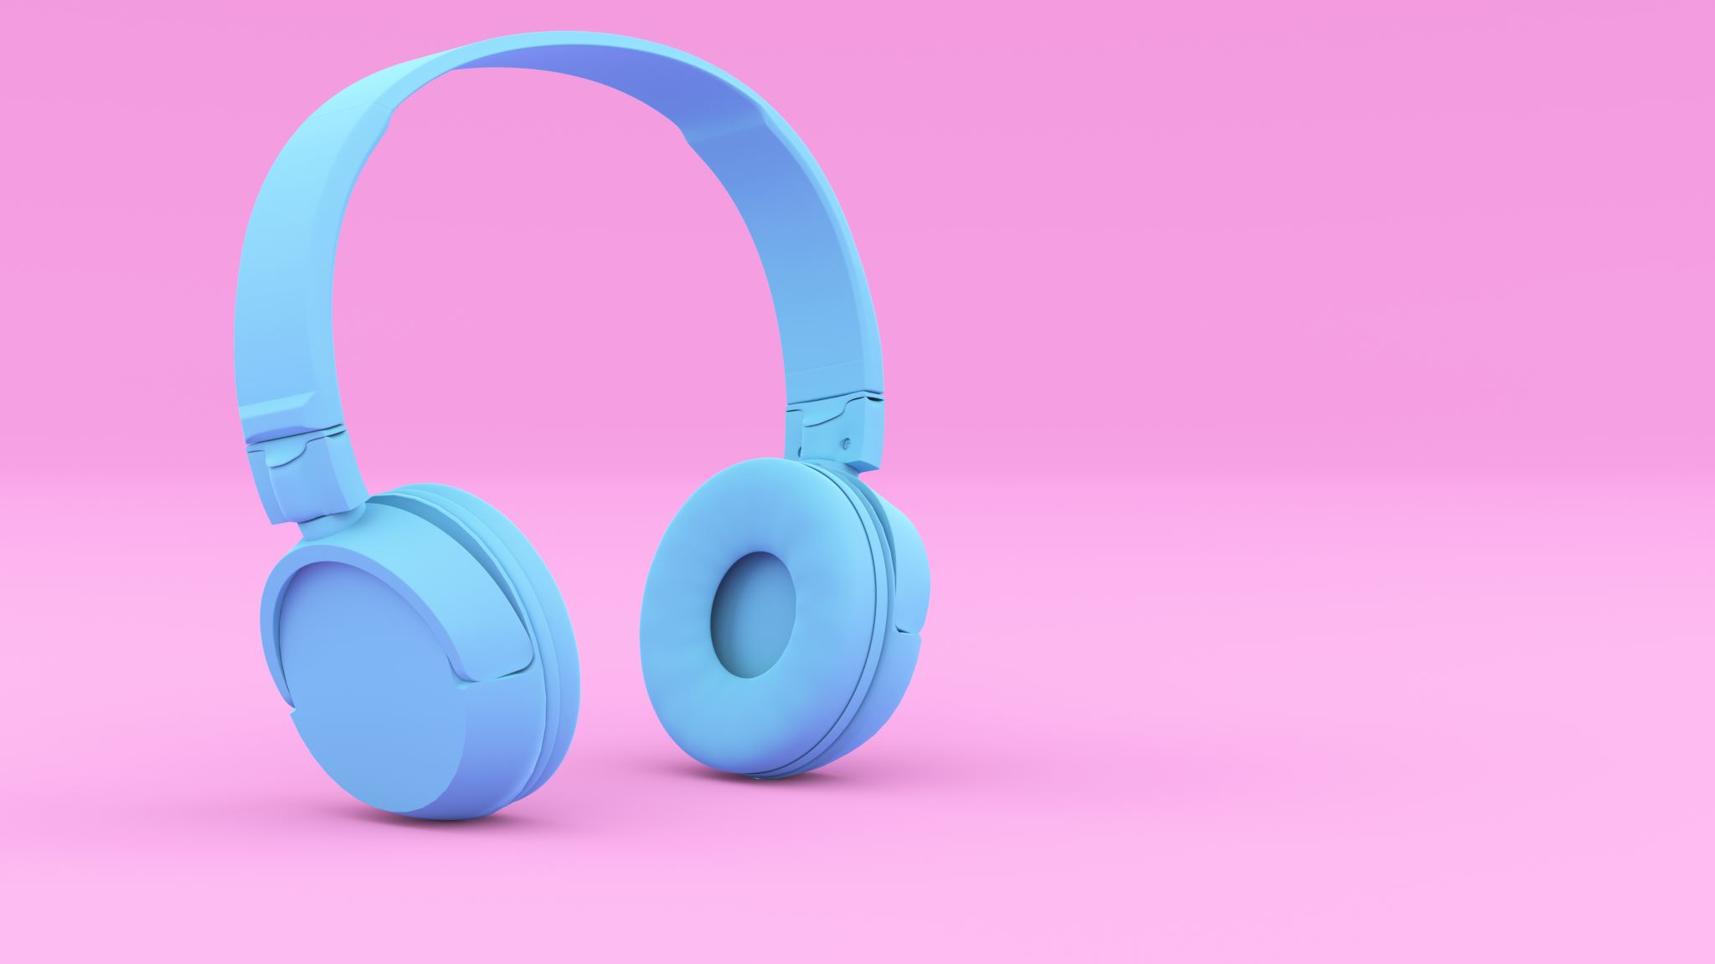
Marketing Strategy for Bluetooth Earbuds
1.Target Audience:
Identify demographics: young professionals, fitness enthusiasts, commuters and tech-savvy consumers.
Understand lifestyle needs: convenience, sound quality and design.
2.Unique Selling Proposition(USP):
Highlight standout features: superior sound quality, long battery life, noise cancellation and ergonomic design.
Emphasize connectivity: seamless pairing, multi-device support and Bluetooth range.

Slide 7
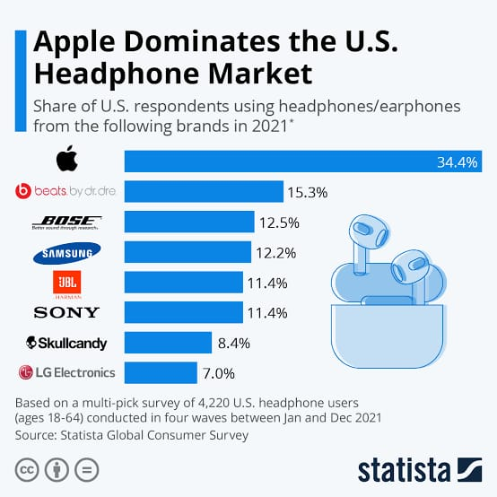
Marketing Strategy for Bluetooth Earbuds
3.Brand Positioning:
Position as a premium product at an affordable price, emphasizing value and quality.
Create a lifestyle brand image, associating the earbuds with active, modern living.
4.Digital Marketing:
Social Media Campaigns: Utilize platforms like Instagram and TikTok for engaging visuals and influencer partnerships.
Content Marketing: Blog posts, videos and tutorials showcasing features, sound tests, and user experiences.
Email Marketing: Regular newsletters with promotions, product updates and tips for usage.

Slide 8
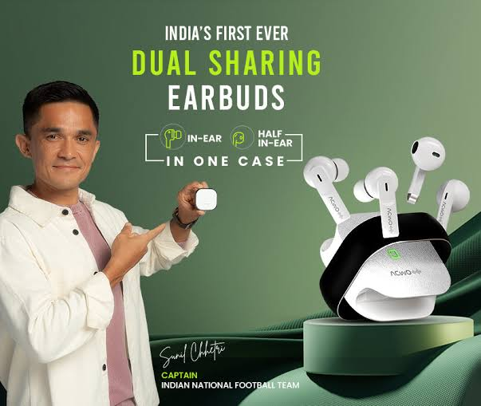
Marketing Strategy for Bluetooth Earbuds
5.Influencer Collaborations:
Partner with tech reviewers and lifestyle influencers for authentic endorsements.
Leverage user-generated content by encouraging customers to share their experiences.
6.Promotions and Discounts:
Launch promotions for early adopters, including bundle deals or limited-time discounts.
Offer referral discounts to encourage word-of-mouth marketing.

Slide 9
Backlog
Research target audience preferences.
Analyze competitor products.
Define key features and specifications.
Design user interface for controls.
Explore materials for housing and ear tips.
To Do
Create initial design prototypes.
Develop sound quality testing protocols.
Identify potential suppliers for components.
Draft marketing strategy and materials.
Plan user testing sessions.
In Progress
Prototyping design and ergonomics.
Conducting sound quality tests.
Developing the app for connectivity and settings.
Preparing promotional content for social media.

Slide 10

TEAM MEMBERS:
Y.DURGA PRASAD
V.PRANAY KUMAR
P.G.VISHWA TEJA
G.ABHILASH REDDY
P.SAI

